Slide 1
Complications of Fractures
Dr Peace Amaraegbulam

Slide 2
Learning Outcomes
Identify the complications of fractures.
Be able to manage acute complications.
Prevent delayed complications.

Slide 3
Fracture complications
May be:
Life threatening.
Limb threatening.
At the time of the fracture.
Due to fracture healing
Due to treatment.

Slide 4
Priorities of fracture treatment
Save life
Save limb
Preserve function

Slide 5
LOCAL COMPLICATIONS
EARLY
LATE
Visceral injury
Vascular injury
Fracture blisters
Compartment syndrome
Nerve injury
Haemarthrosis
Infection
Delayed union
Non-union
Malunion
Joint stiffness
Myositis ossificans
AVN
CRPS
Osteoarthritis

Slide 6
Systemic Complications
Fat embolism
Shock
Thromboembolism
Pneumonia

Slide 7
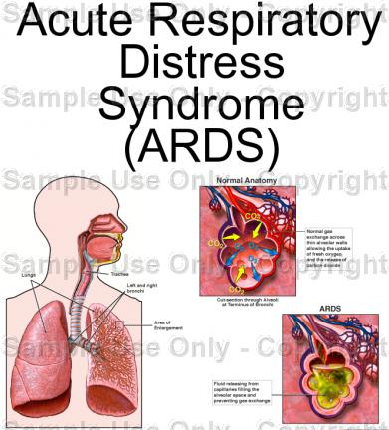
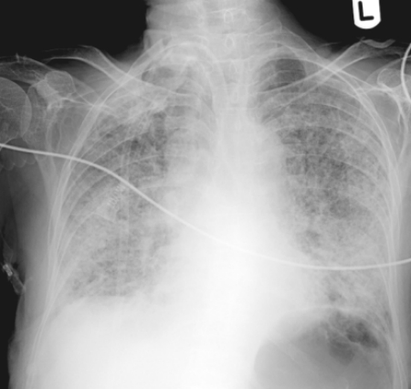
FAT EMBOLISM SYNDROME // ARDS

Slide 8
PREVENT AND TREAT
RESUSCITATE
O2
BLOOD
STABILIZE FRACTURES
ADEQUATE PAIN RELIEF
VENTILATE ?

Slide 9

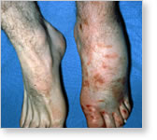
COMPARTMENT SYNDROME
Increased pressure,
in a closed fascial compartment
resulting in local tissue ischaemia

Slide 10
TISSUE SENSITIVITY
NERVE :
2-4 hours ( but can regenerate )
Muscle :
6-8 hours ( but can not regenerate )
Replaced by fibrous tissue : contracture

Slide 11
COMPARTMENT SYNDROME
High index of suspicion
Combination of physical signs and symptoms: 5 Ps.

Slide 12
Haemarthrosis
BLOOD IN THE JOINT
PAINFUL !!!!
Aspiration under sterile conditions.

Slide 13
Take Home
Identify possible fracture complications.
Remember the priorities of treatment.
Appropriate care to reduce complications from fractures.

